Slide 1
Phase Transitions in Financial Markets: An Entropy-Based Approach to Regime Detection
Group 8: Andreas Adamantos, Pranav Bali, Tarreau Boone, Lorenzo Mainetti

Slide 2
Why financial markets?
Financial markets are complex systems where hundreds of assets interact simultaneously, and their collective behavior shifts dramatically during crises
Asset correlations can determine the behavior of the overall system, and changes in those correlations can act as indicators of a phase transition.
We want to characterize the dynamics of the market without relying on arbitrary thresholds or fitted parameters

Slide 3
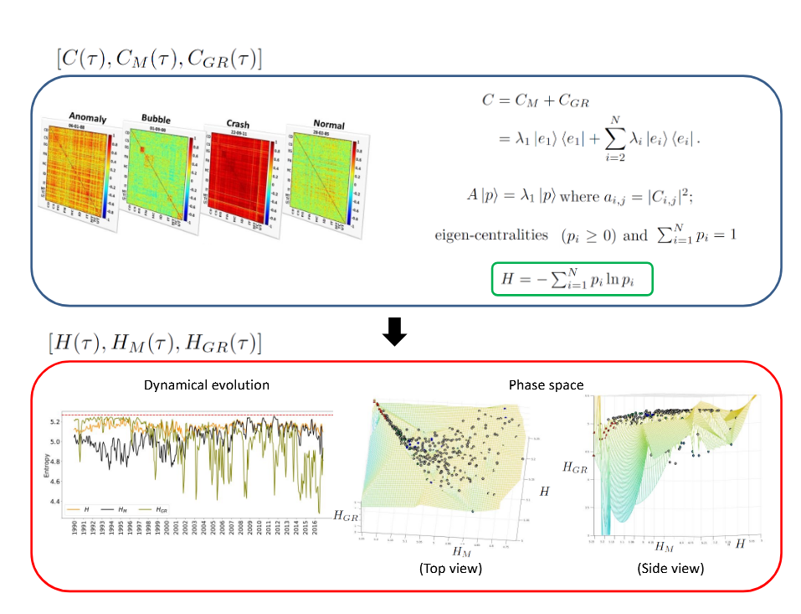
Phase separation and scaling in correlation structures of financial markets
Provides a methodology that would help understanding and foreseeing tipping points in complex systems.
extract information about the disorder in the market using the eigen-entropy measure
Shows how different market events undergo phase separation
Kukreti, V., Pharasi, H.K., Gupta, P., & Kumar, S. (2020). A perspective on correlation-based financial networks and entropy measures. Frontiers in Physics, 8, 323.

Slide 4
Research Questions
Can entropy measures derived from correlation matrix eigenvectors reliably distinguish between normal trading periods and market stress events?
How do the dominant market mode and sector-specific modes behave differently during crashes versus calm periods?
Does the market's trajectory in a low-dimensional phase space defined by correlation, entropy, and eigenvalue exhibit predictable patterns before major transitions?

Slide 5
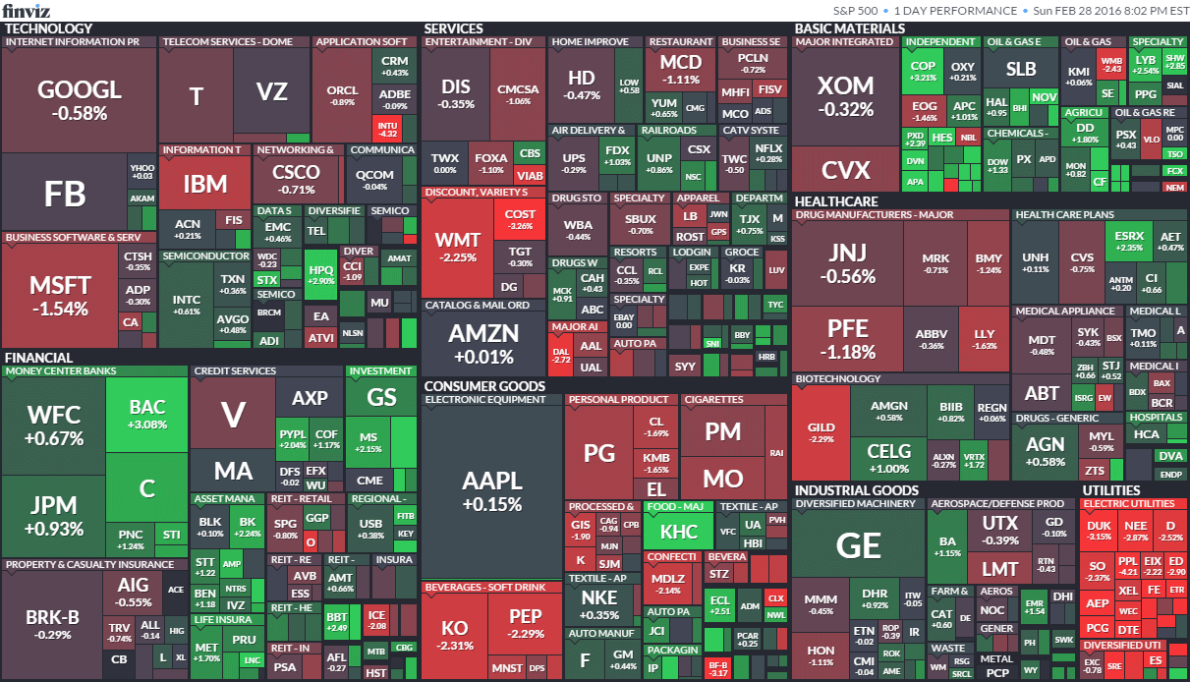
Data preparation
Top 200 stocks of S&P 500, from 1985 to 2025.
Spans different periods of calm and crisis
Log returns computed to compare relative changes.
Back filling and forward filling used for missing data

Slide 6
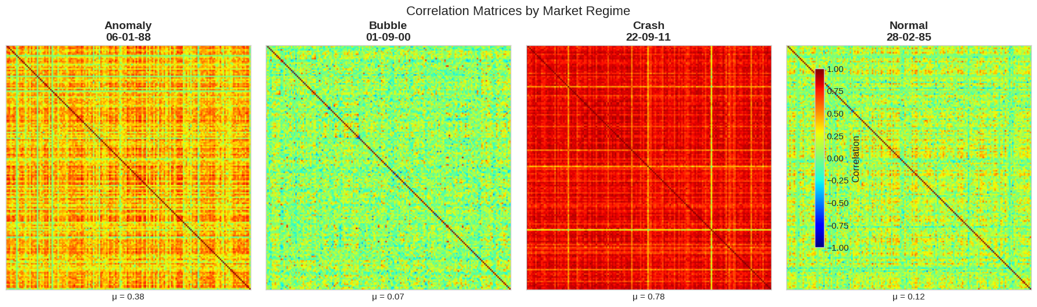
Rolling window
Rolling window of returns used to capture changing market structure
Each window is one correlation matrix.
We used a window of 40 days, and shifted it by 20 days each time

Slide 7
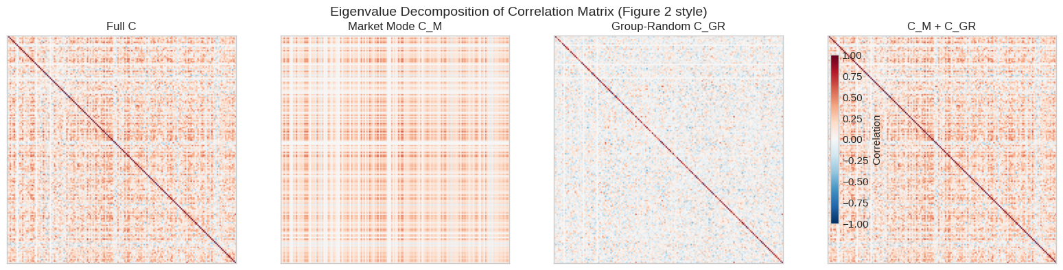
Correlation modes
Correlation matrix C decomposed into market modes (CM) and composite group plus random modes (CGR)
CM captures movement of entire system
CGR captures movements of select sectors (Groups), as well as noise (Random)

Slide 8
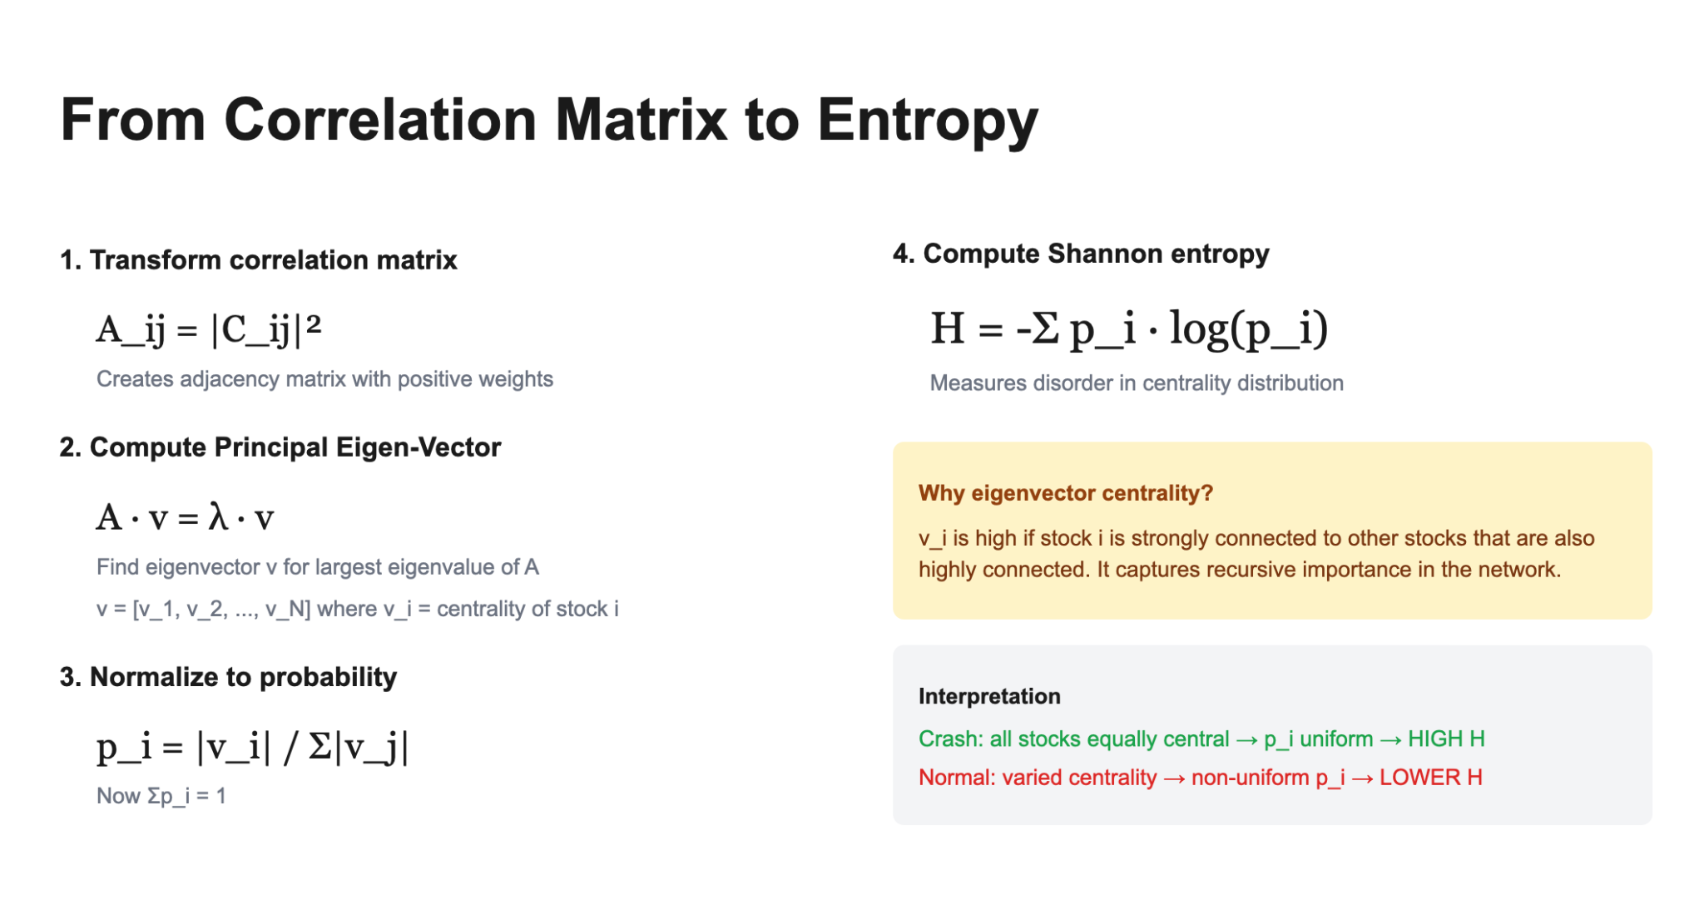

Slide 9
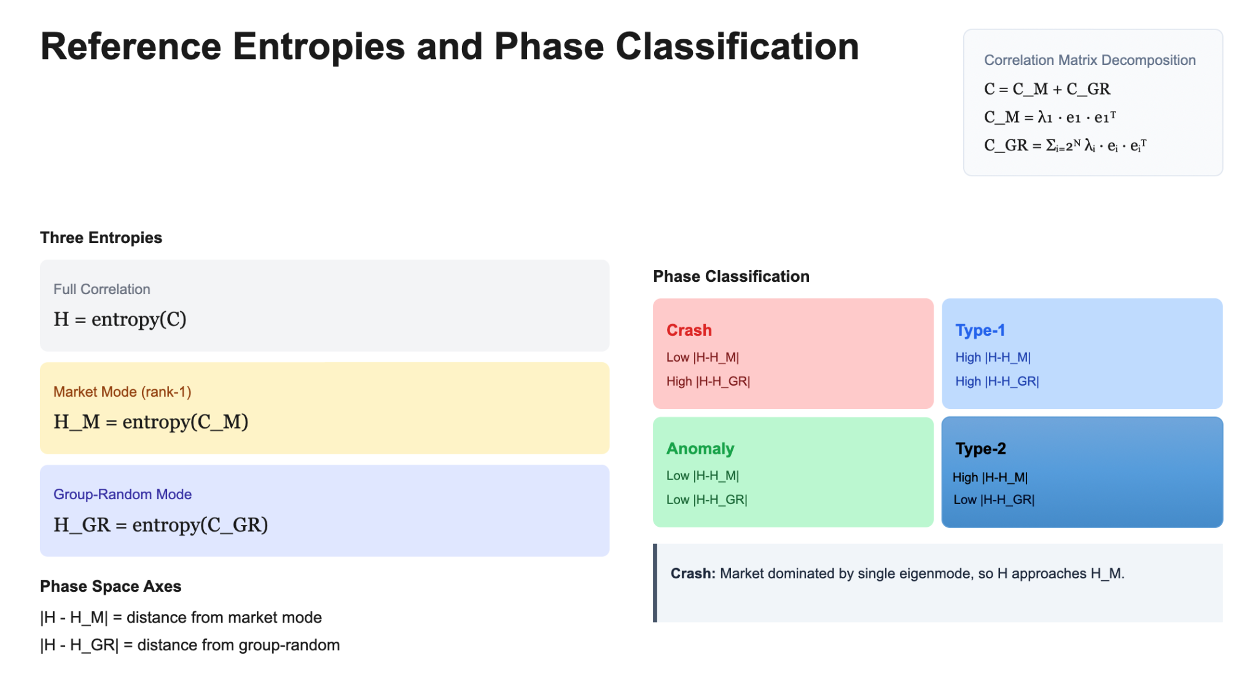

Slide 10
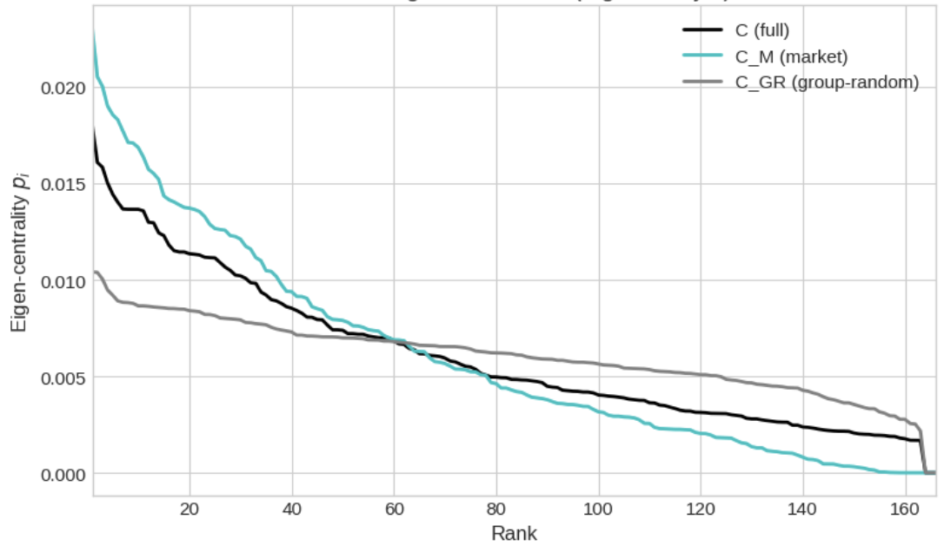
Ranked Eigen-Centrality Distribution
1) The market mode is constructed
by retaining only the largest
eigenvalue–eigenvector pair
of the correlation matrix in
its spectral decomposition.
2) The largest eigenvalue represents
the strongest common factor,
keeping only this mode captures
market-wide synchronization.

Slide 11
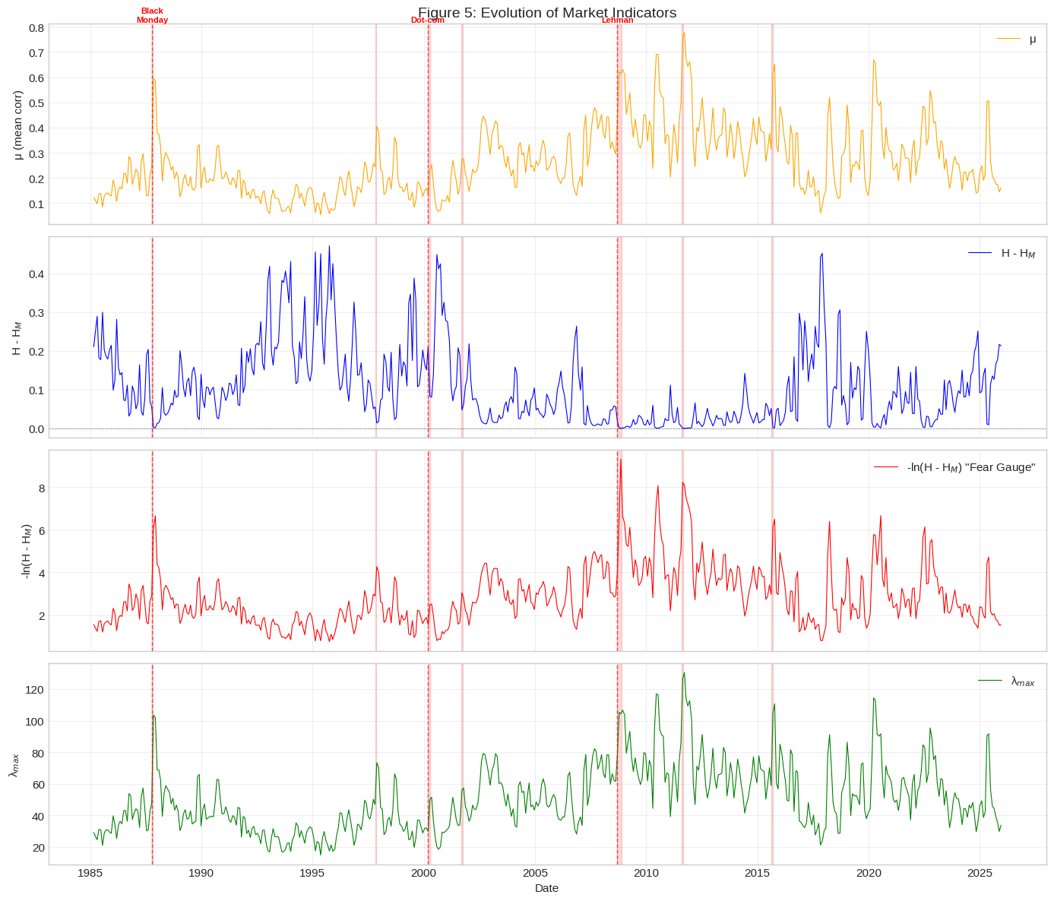
Evolution of
Market Indicators

Slide 12
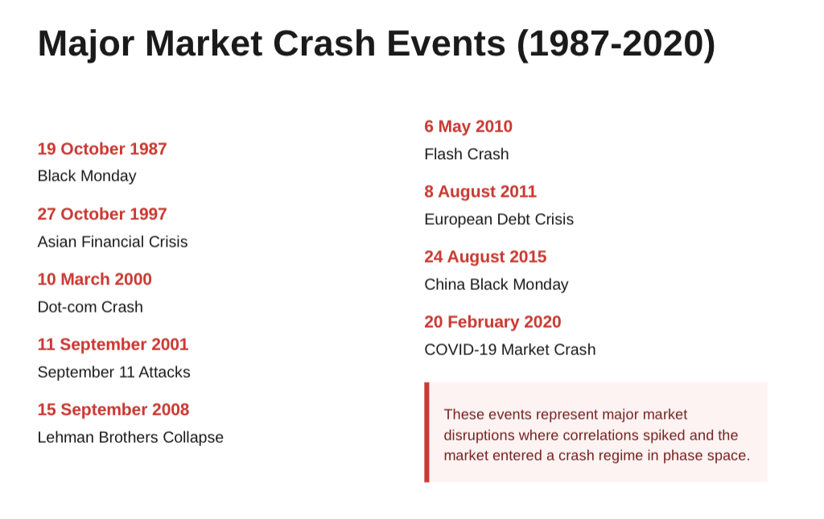

Slide 13
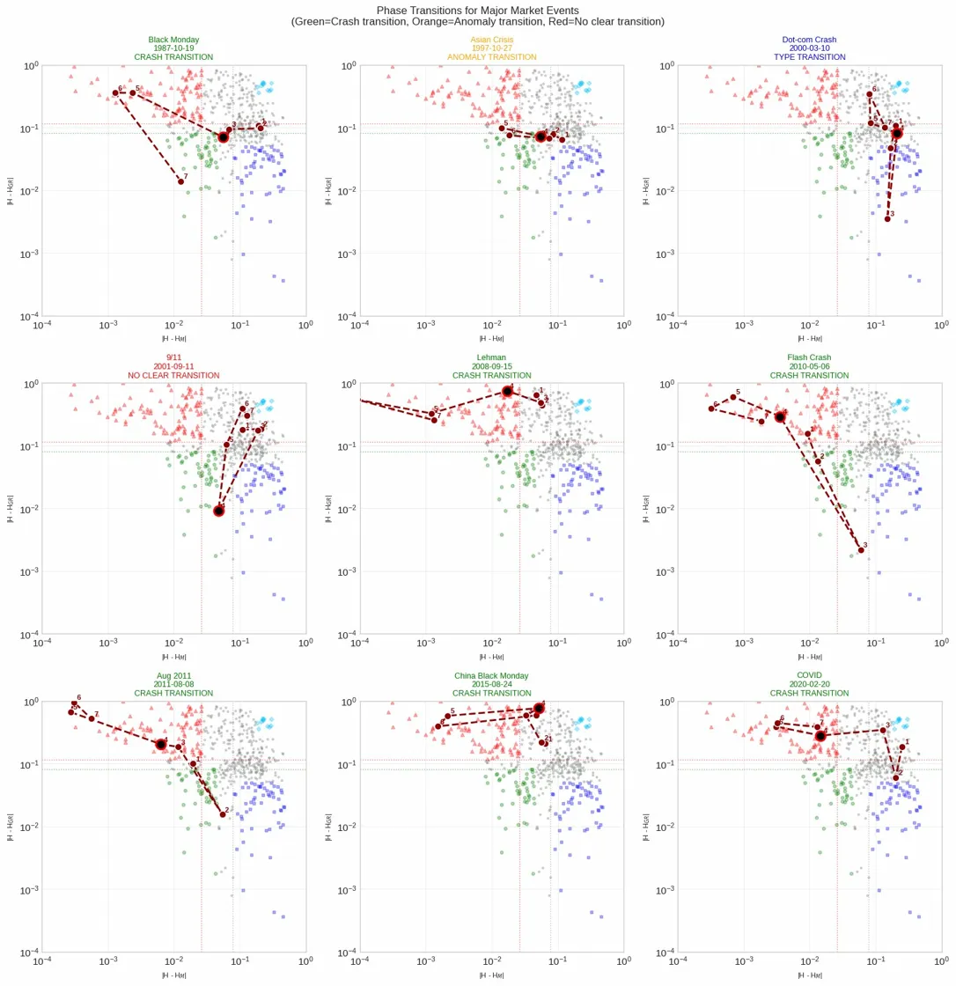
Phase Space Transition Plots
9 Historical Crash Events
Clear Phase Transition seen on 6

Slide 14
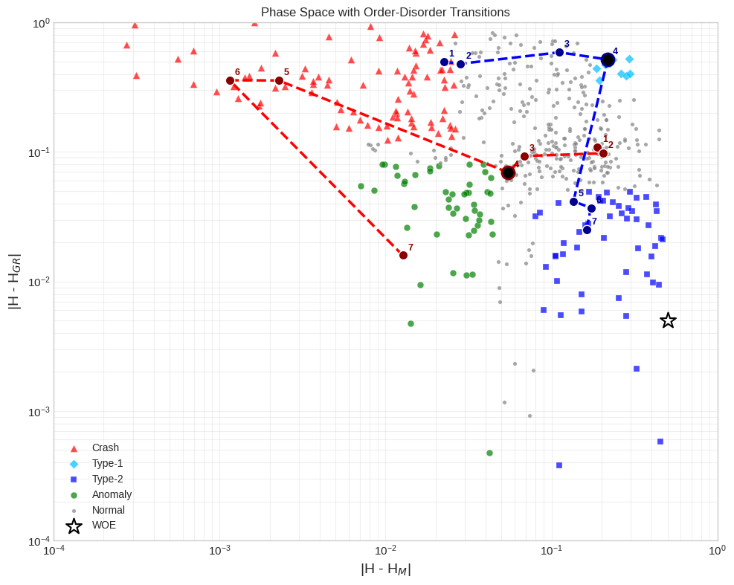
Clearest Phase Transition seen for
Black Monday
&
Dot-com Bubble
(* Few Anomalies exist)

Slide 15
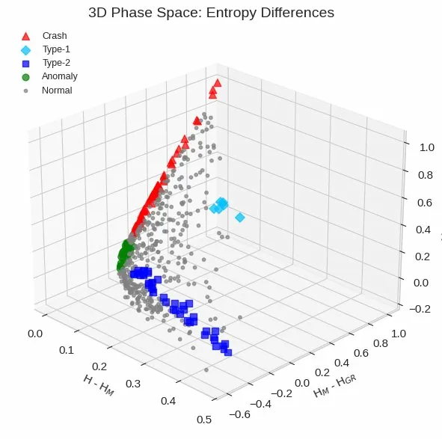
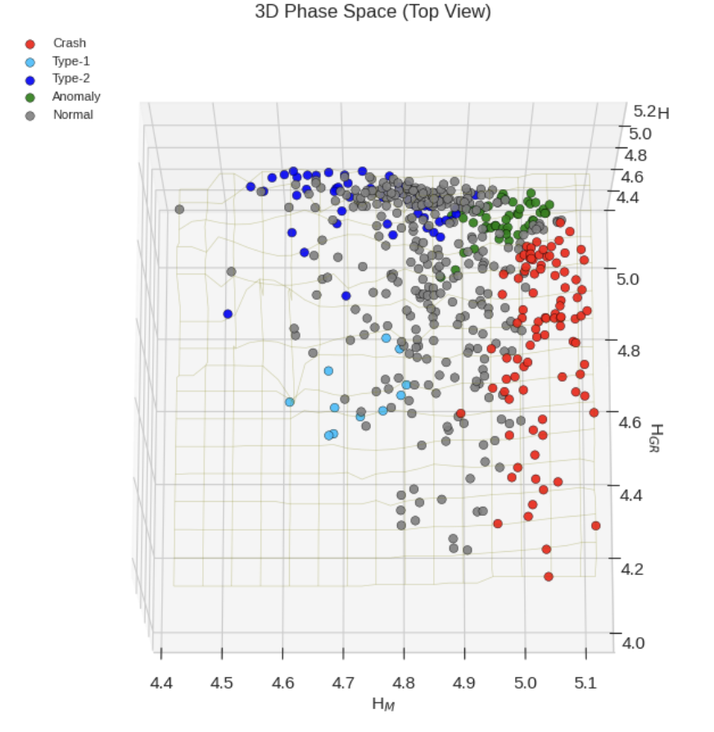
3D Phase Space plots for reference

Slide 16
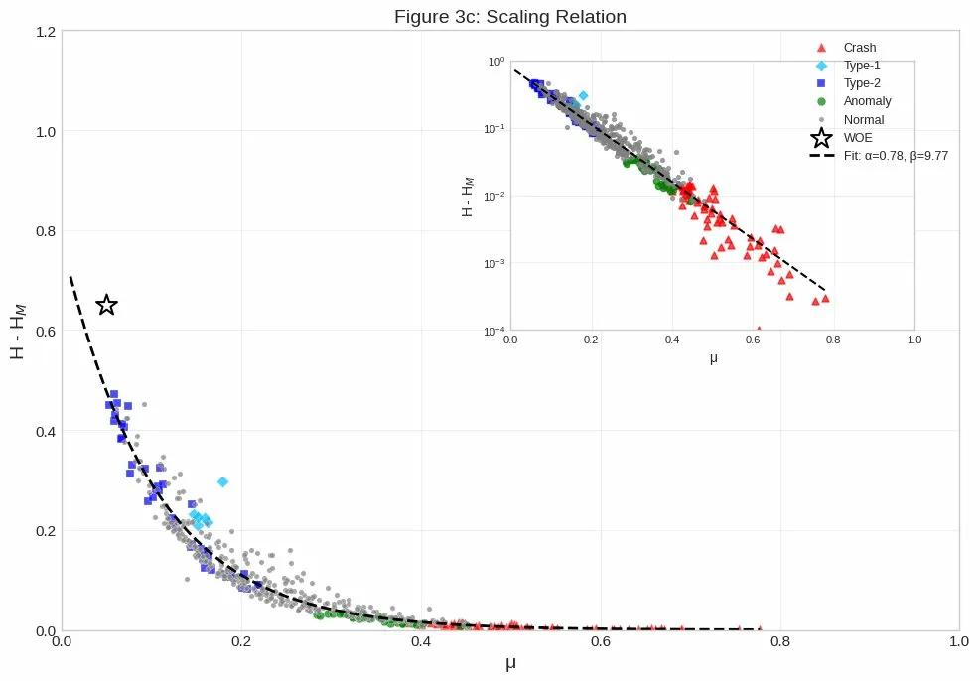
Scaling relation
Exponential relation between
H - H_M vs μ
Crash events are located
at the bottom at higher μ
(shows strong correlation in crashes)
Universal organizing principle
(Inset is log-scaled)

Slide 17
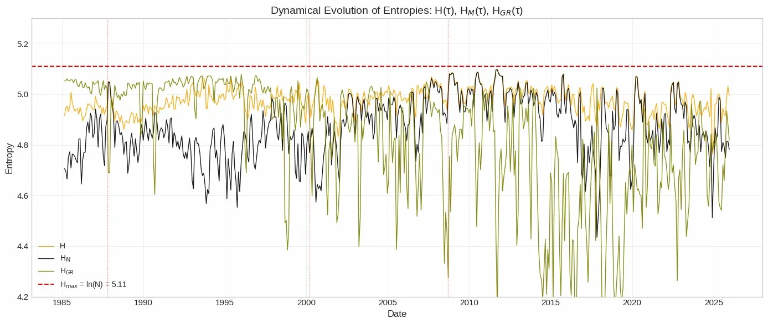
Evolution of Entropies

Slide 18
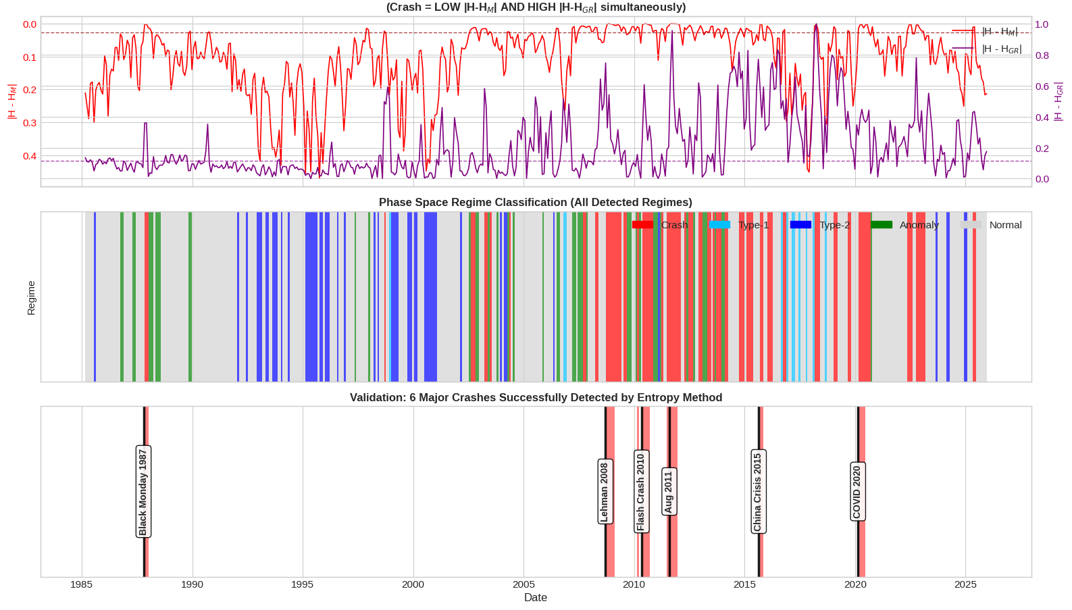

Slide 19
Can We See a Crash Coming?
Does the market's trajectory in a low-dimensional phase space defined by correlation, entropy , and eigenvalue exhibit predictable patterns before major transitions?
Is there a stable, recurring pre-crash region that we can detect?
Hypothesis: Major market crashes are preceded by a systematic approach toward a common pre-crash region in a low-dimensional phase space defined by correlation, entropy, and eigenvalue structure.
Normal
Pre-Crash?
Crash

Slide 20
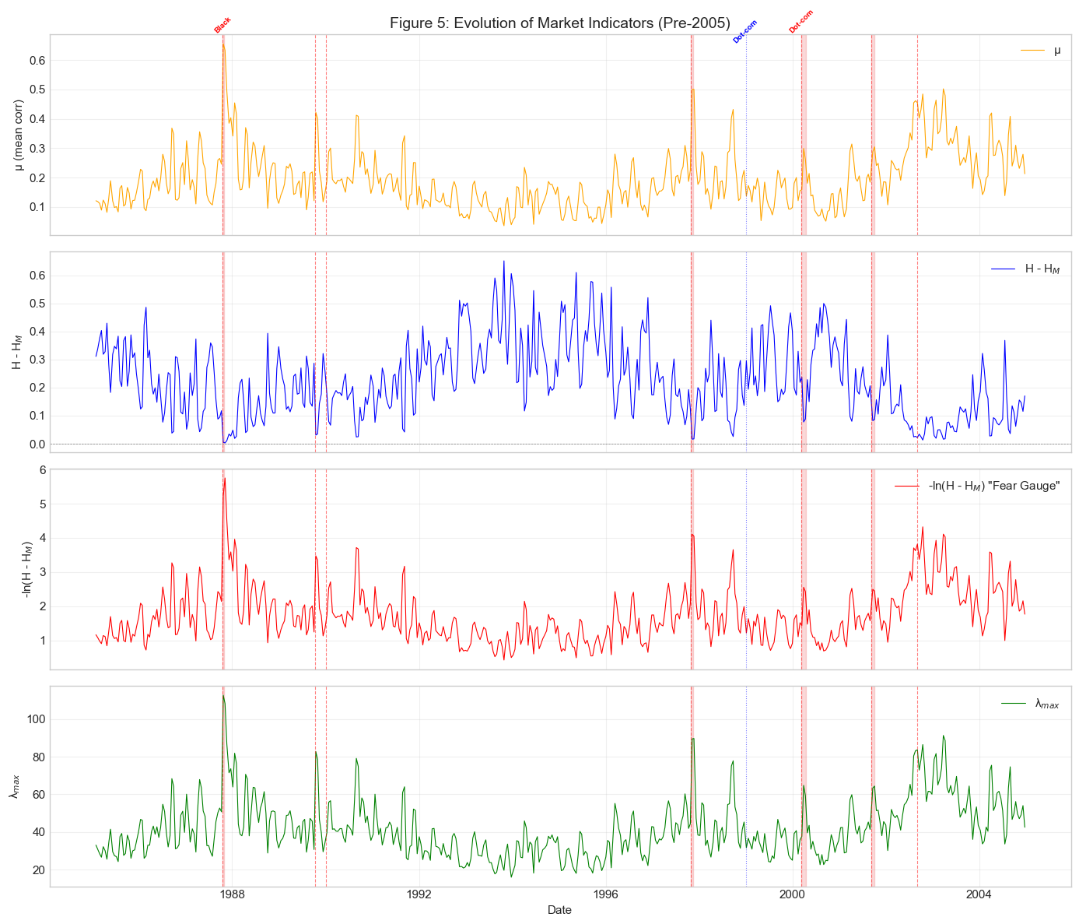
From Correlation to Phase Space
Z-scored |H−H_M|, μ, λ_max
Pre-Crash Centroid
Mahalanobis Distance

Slide 21
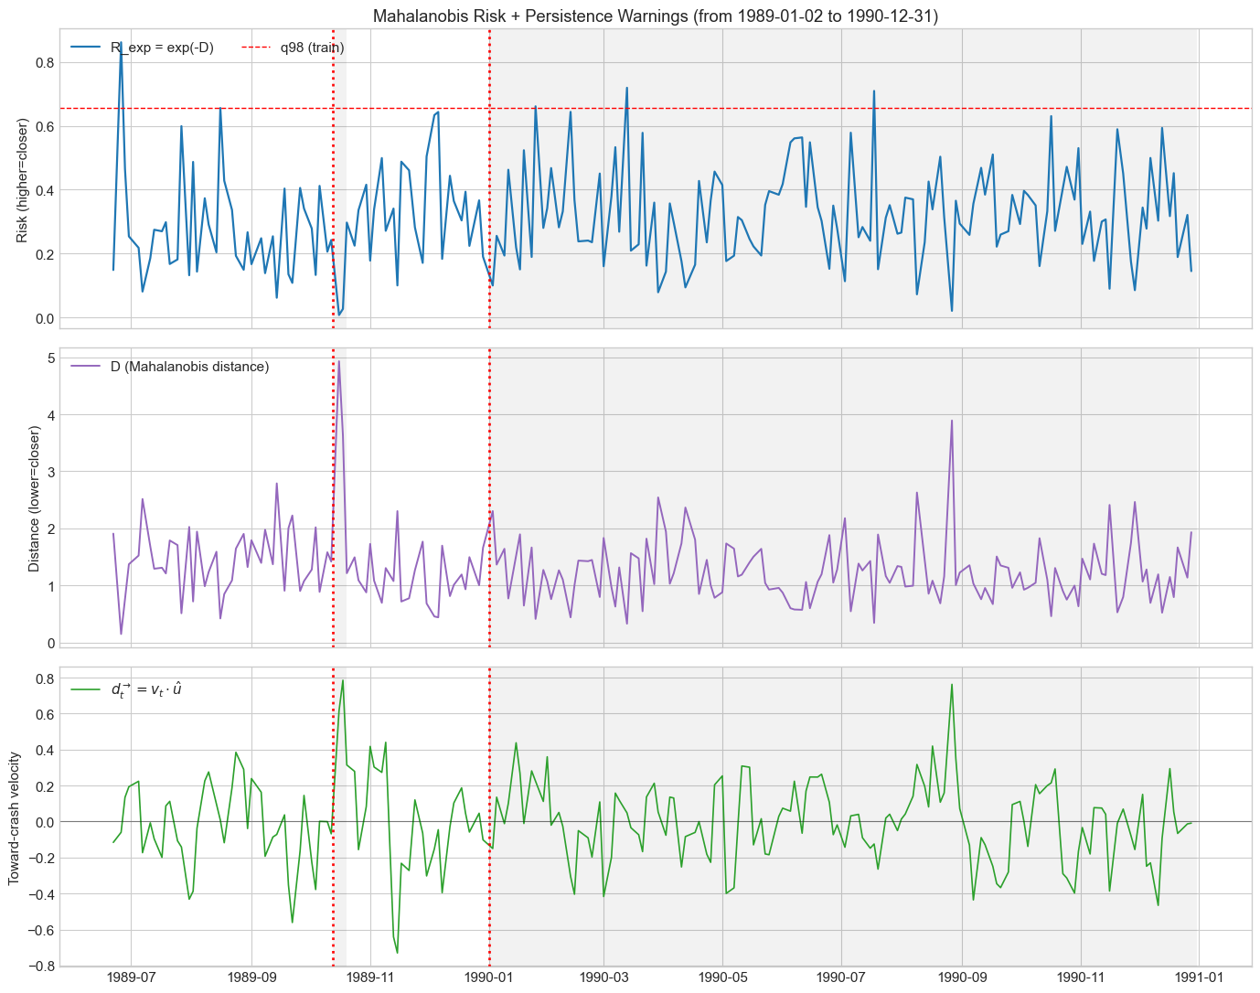
Pipe Line
Risk-Score = Exp(-D)
2 days above Threshold
Moving toward Pre-Crash Region

Slide 22
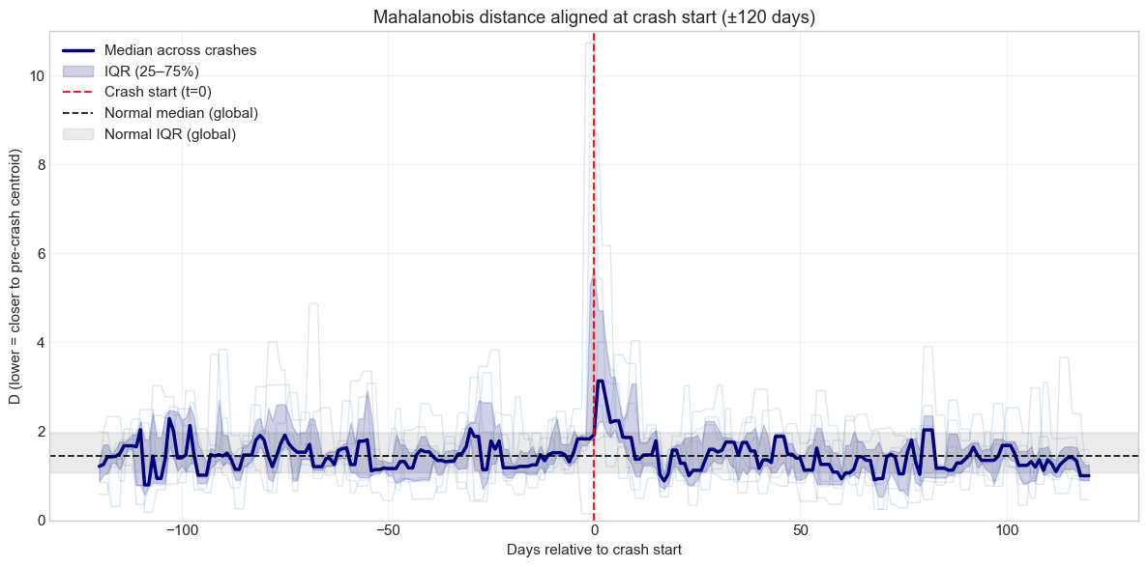
No Systematic Approach to Crashes

Slide 23
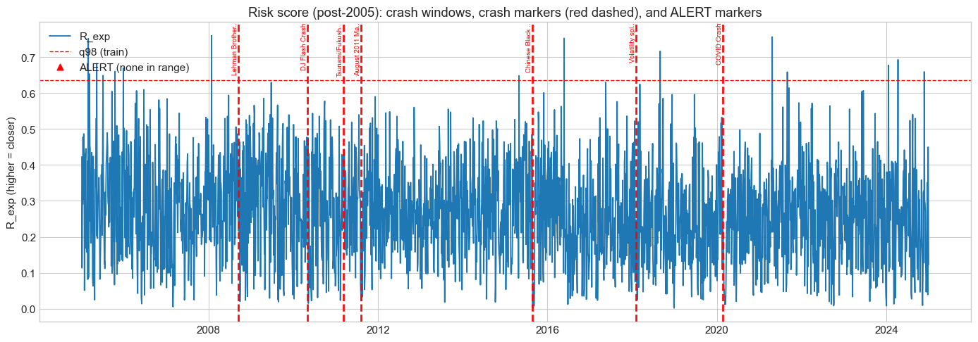
No Predictive Results

Slide 24
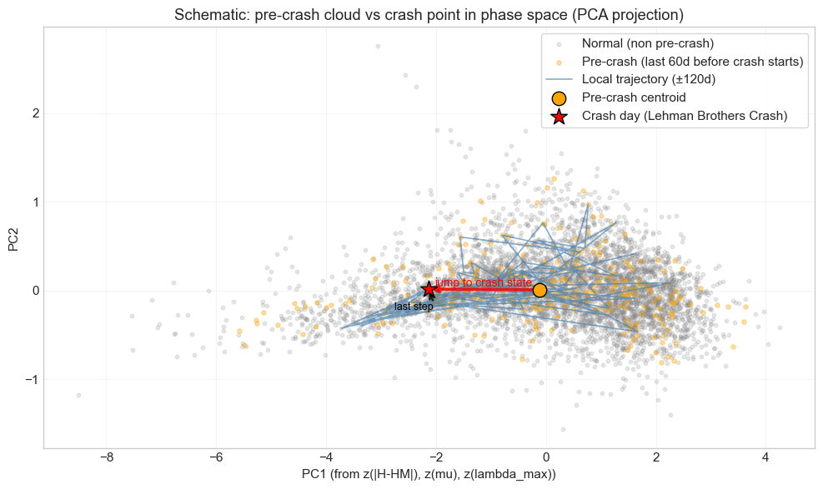
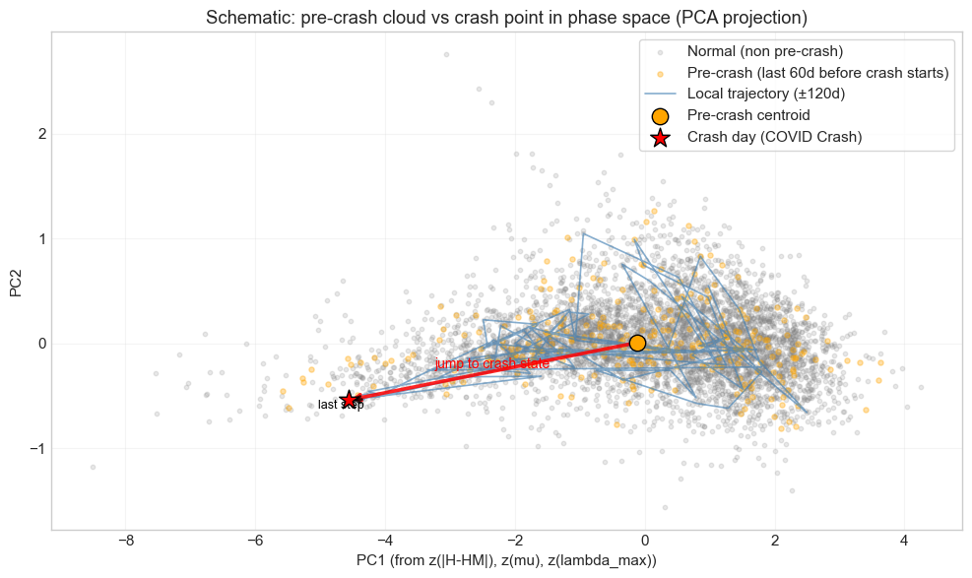
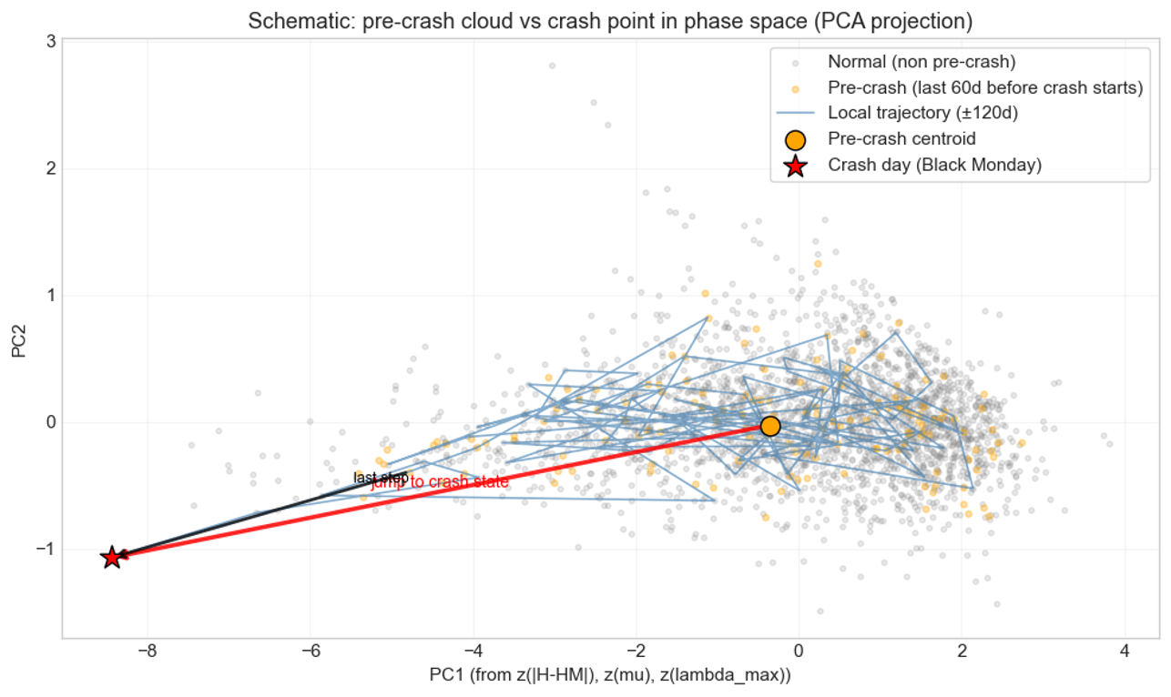
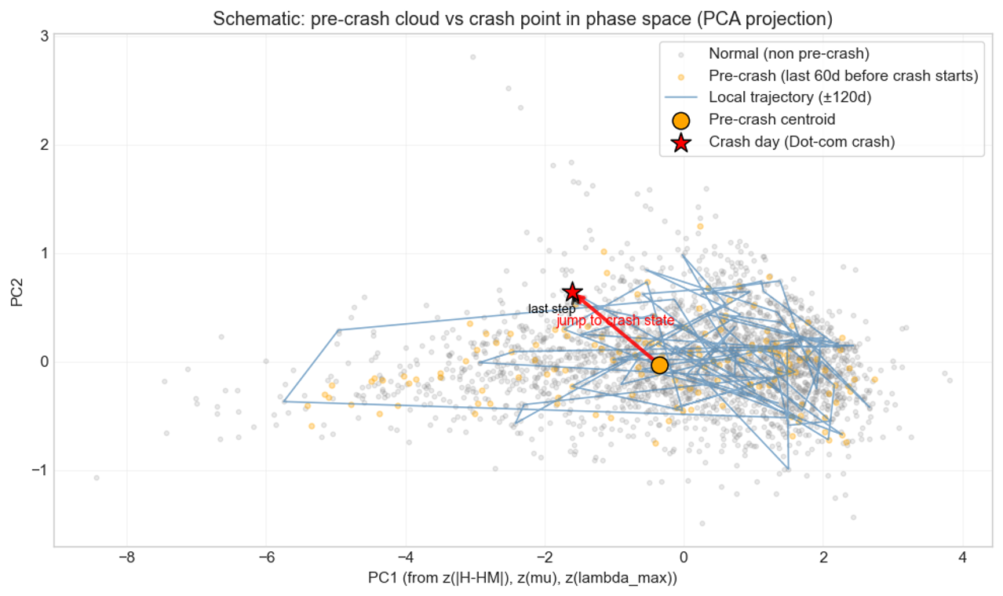
Trajectories are Heterogenous

Slide 25
Conclusion
Market behavior changes clearly between calm periods and crises.
During crises, the market acts as a single dominant system.
Correlation-based measures capture these changes very clearly.
Entropy summarizes market organization in a compact way.
Calm periods correspond to more distributed correlations and higher entropy.
Crisis periods are marked by a strong reduction of entropy and loss of diversification.

Slide 26
Conclusion
Known crashes and bubbles tend to occupy different regions in phase space.
Results reproduce the main qualitative findings of the paper.
Confirmed a stable relationship between correlation and entropy.
Crisis transitions are visible but not identical across events.
Method describes market stress well but does not reliably predict crashes.
Framework is best suited for monitoring and interpretation.

Slide 27
Questions?

Slide 28
Appendix

Slide 29
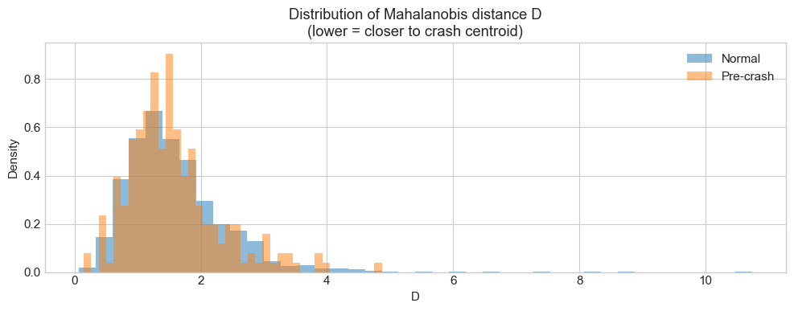

Slide 30
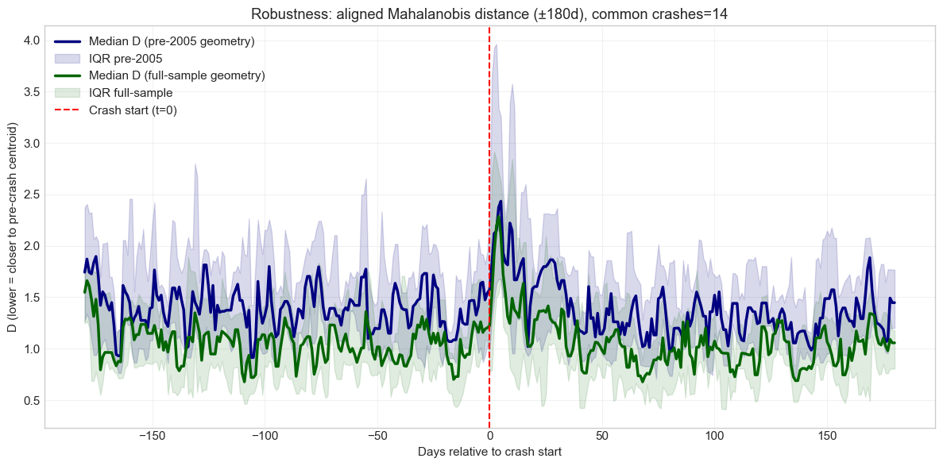

Slide 31
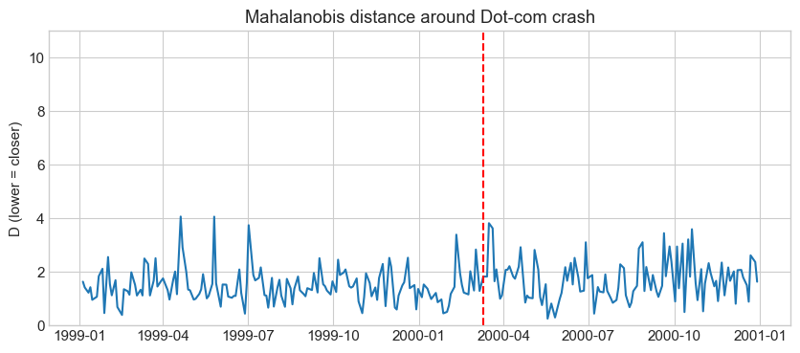
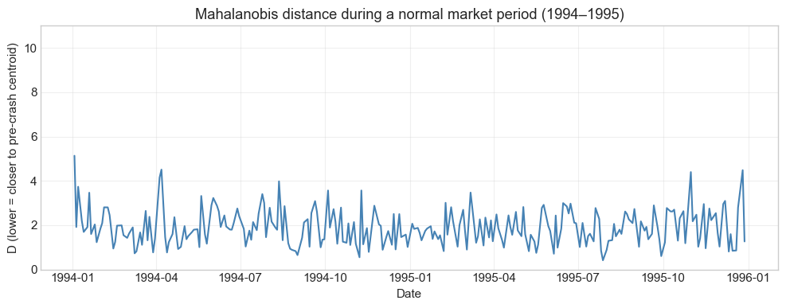
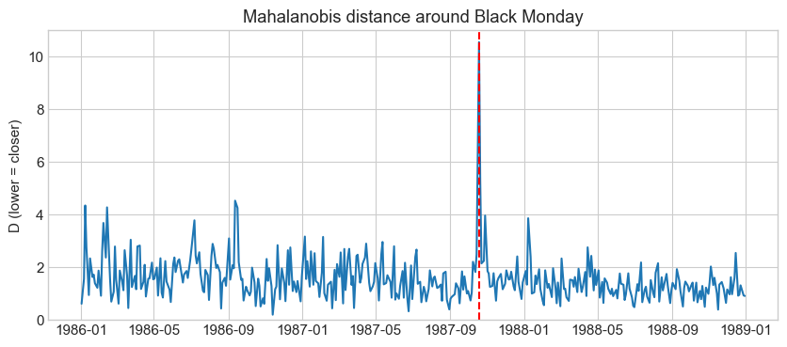

Slide 32
